Slide 1
Creating a Databrick environment in Azure
Create an Azure subscription (https://azure.microsoft.com/en-us/free/search/)
Create a resource group
Create resource(s)
Open workspace
Create cluster
Add data
Create notebook

Slide 2
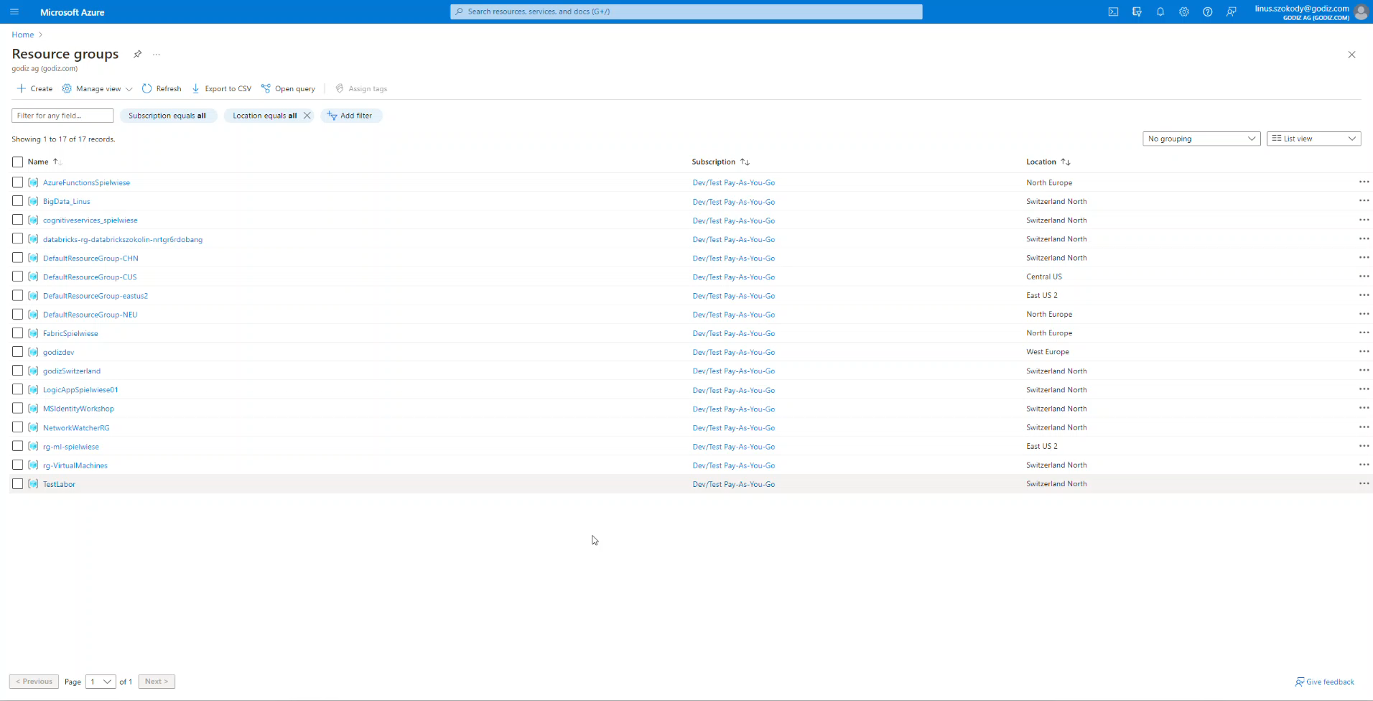
Create resource group
Create a new resource group with the naming convention for your environment.
In this resource group we will later add the Databricks workspace

Slide 3
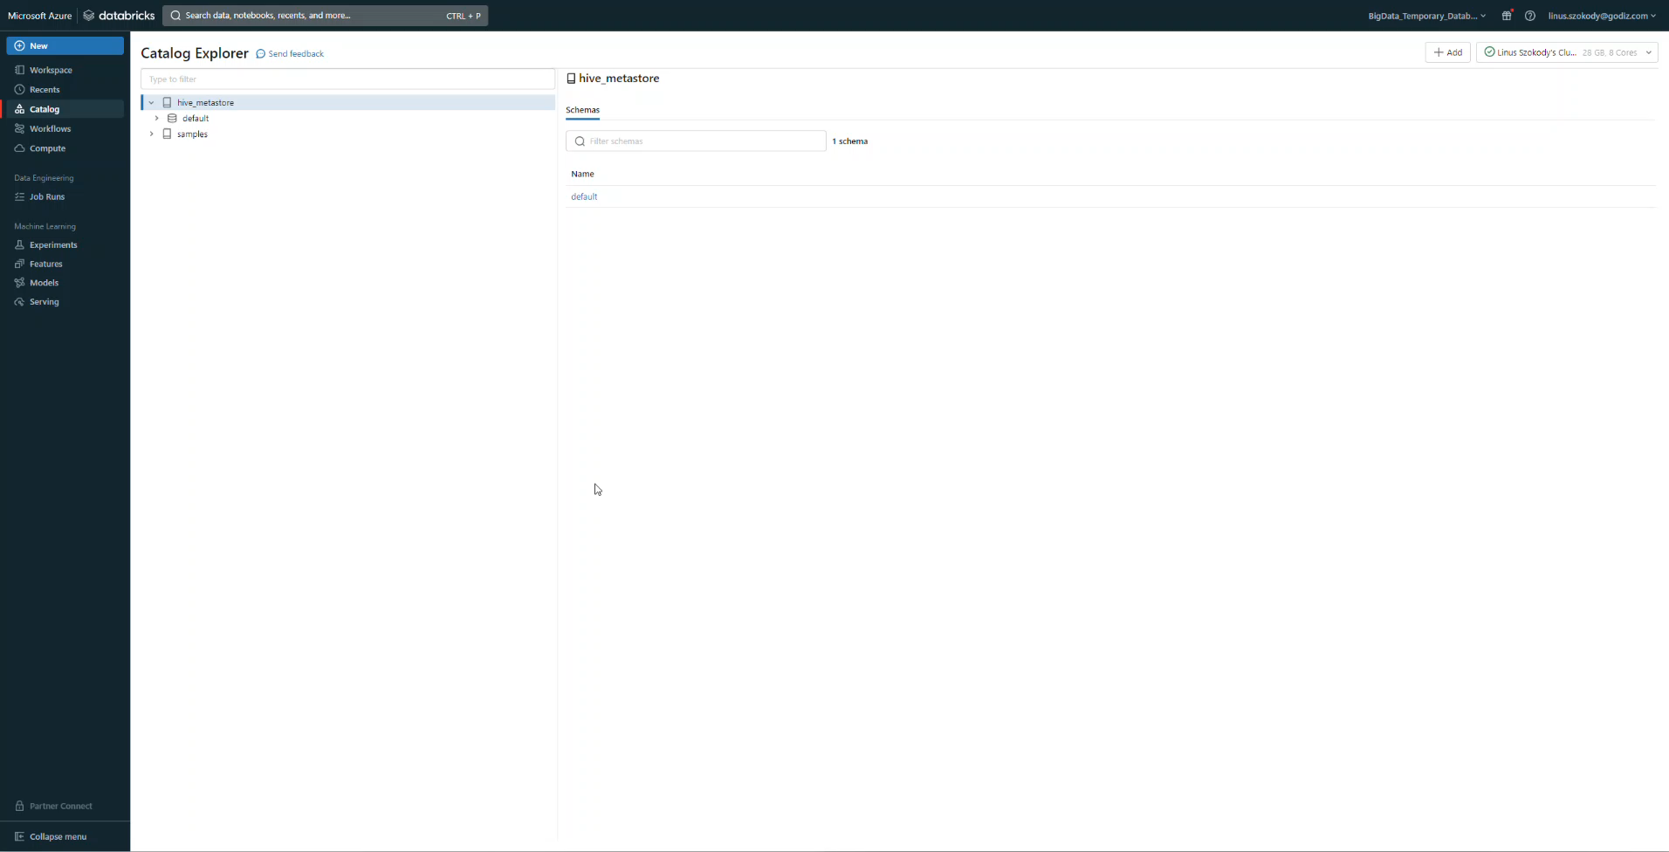
Create Resource(s)
Create a new “Azure Databricks” Resource in your resource group.
Configure the settings depending on your needs (as a sample, we leave everything on NO)
When creating an “Azure Databricks”-resource there will be a second resource group created (“Managed Resource Group name”). This new Resource group will contain a storage account, a network security group, a virtual network and a managed identity. These resources are needed to run the Azure Databrick Workspace.

Slide 4
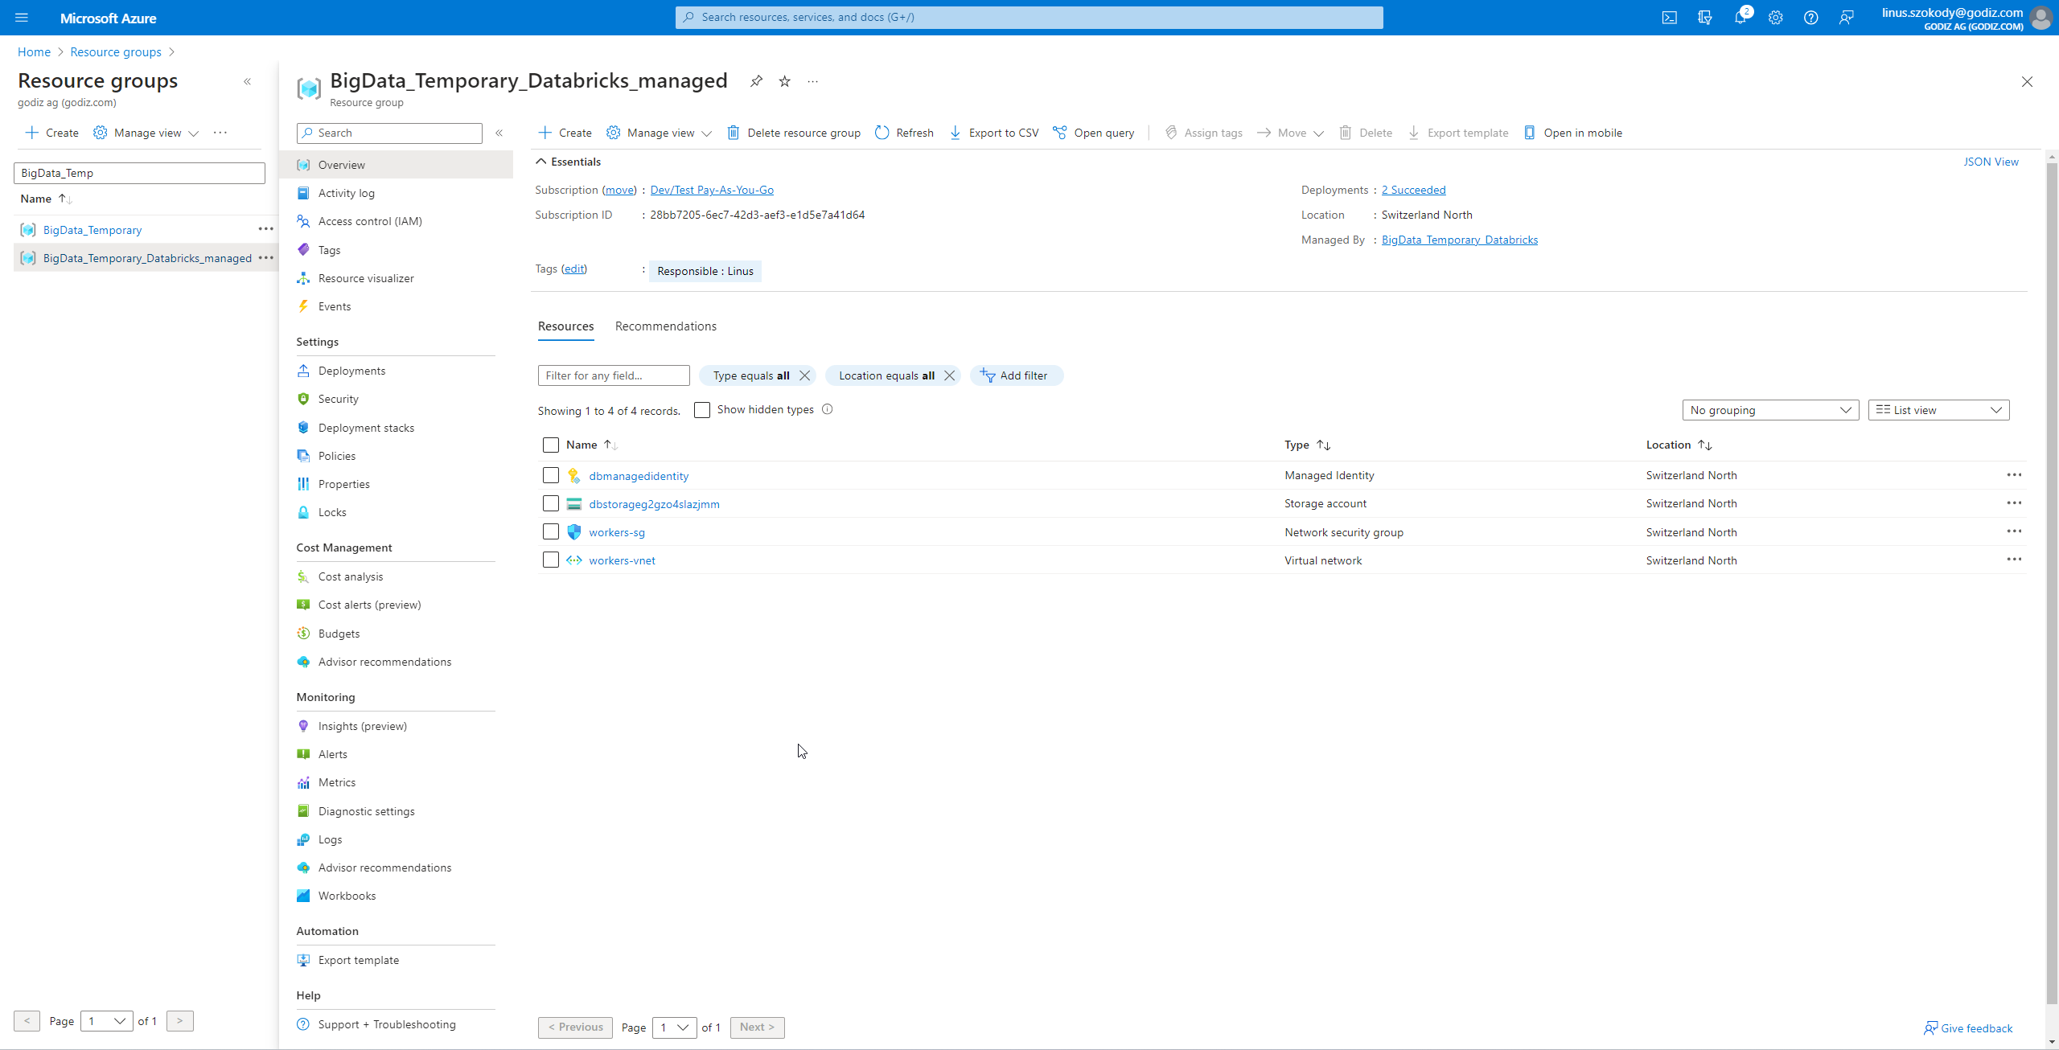
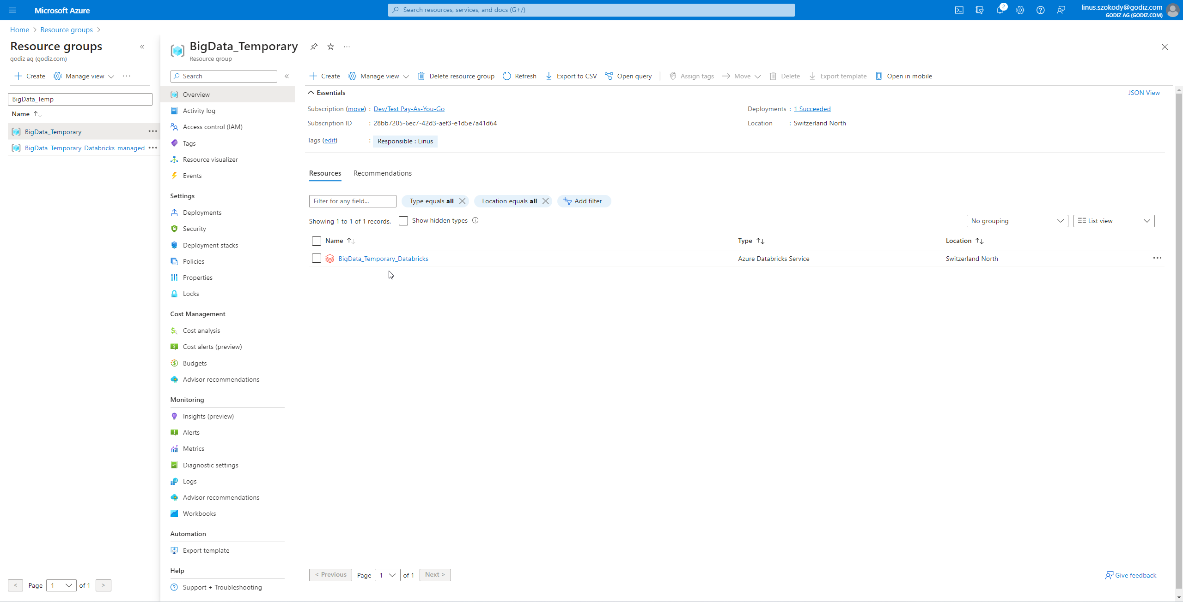
Open Workspace
Two resource groups should have been created

Slide 5
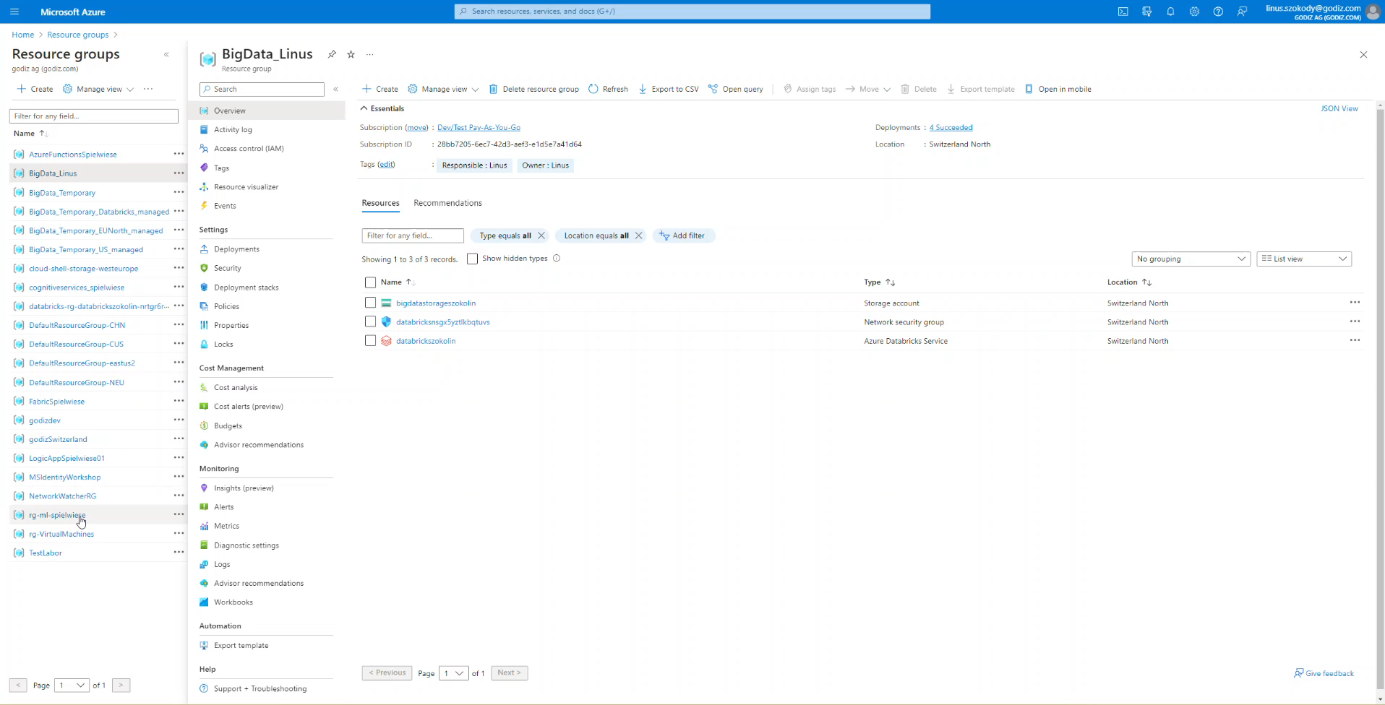
Open Workspace
When opening the “Azure Databricks”-resource you will see this overview.
You can now open the Workspace with the “Launch Workspace”-button in the middle of the screen

Slide 6
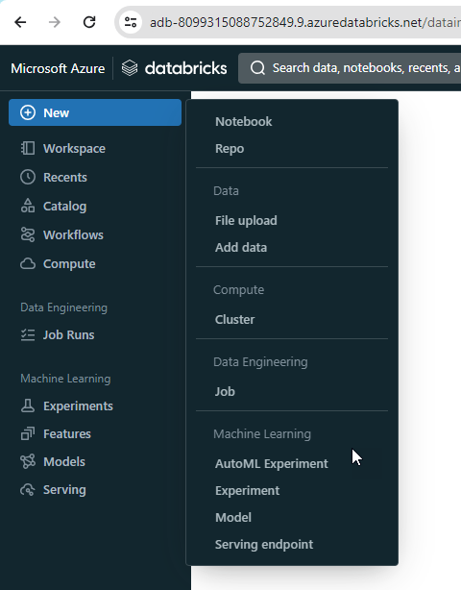
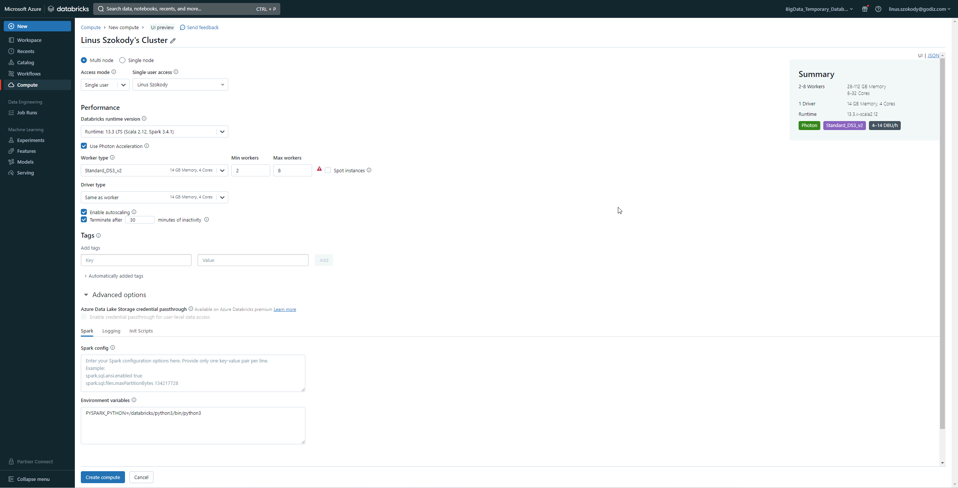
Create Cluster
When creating a compute resource you can select what sparks runtime it should run and what type it should be (RAM, CPU Cores, HDD/SDD, etc.)

Slide 7
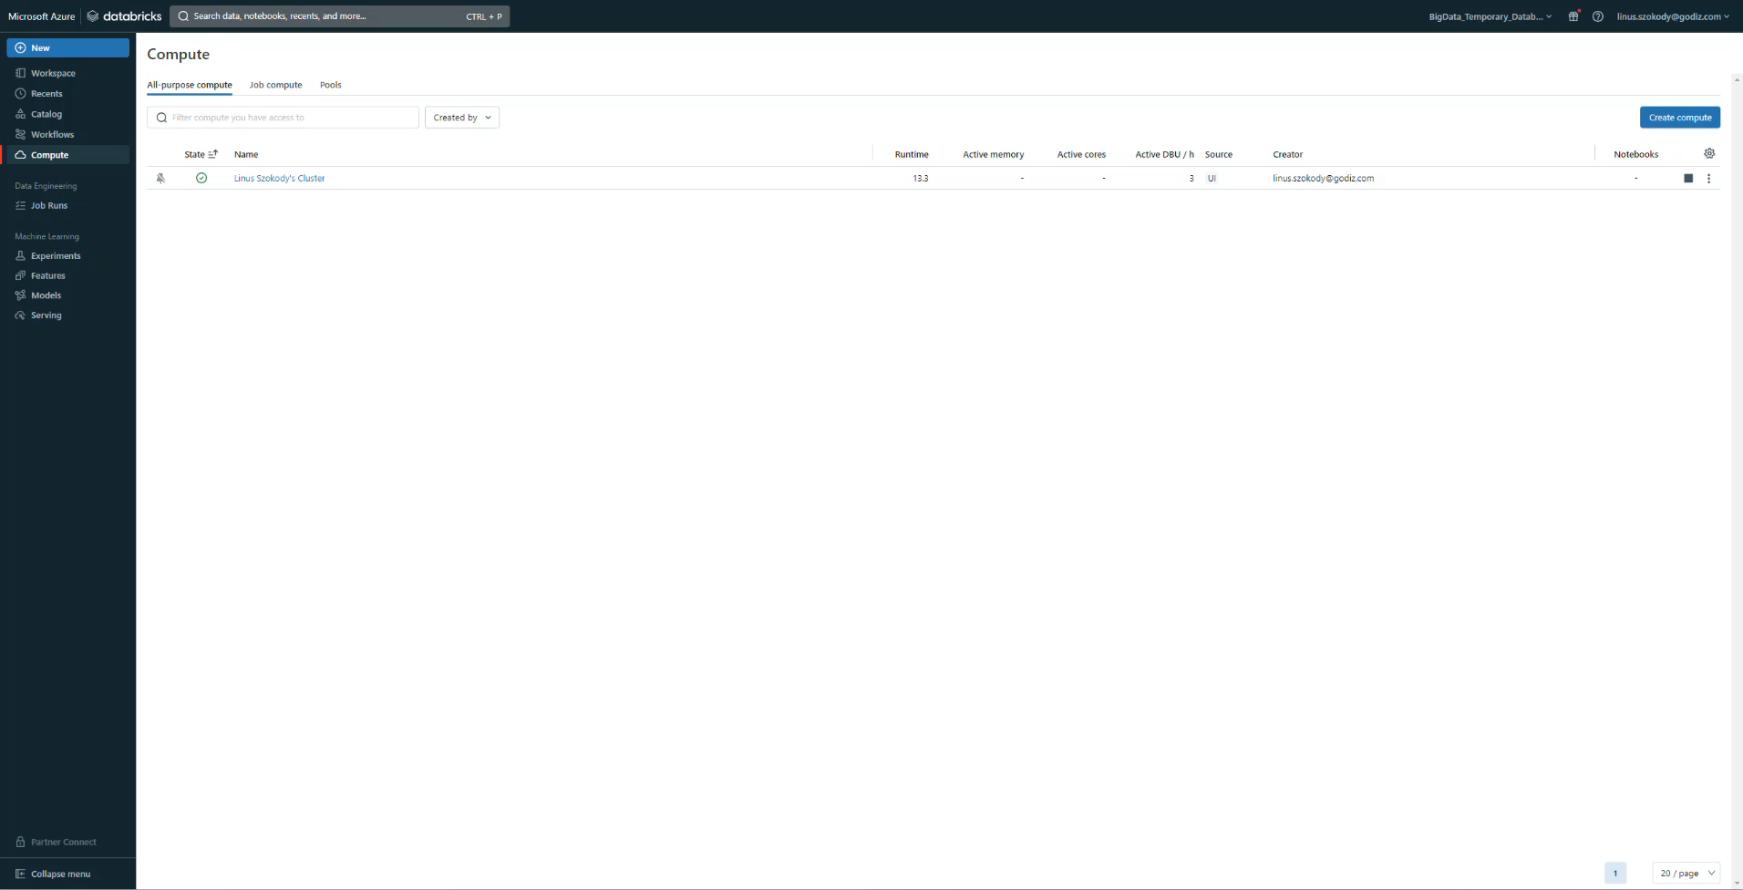
Add Data
Data can be added via a lot of already existing connections or just as a simple File upload

Slide 8
Create Notebook
“spark” is automatically set as the spark context and with that we can access the table we just created.
In the top right we can select on what compute resource we want to run the notebook.
When the job is executed we can see the sparks logs

Slide 9
Resources
Overview:
https://azure.microsoft.com/en-us/products/databricks
Microsoft Learn:
https://learn.microsoft.com/en-us/azure/databricks/introduction/
Pricing:
https://azure.microsoft.com/en-us/pricing/details/databricks/

